Slide 1
BCT 2205
Electronics
LECTURE 1 - INTRODUCTION

Slide 2
Course Contents
Electronic components: Passive components; Resistors, capacitors, inductors, colour codes.
Current and voltage characteristics, Ohm’s law, power rating, measurement of current and voltage.
Active components; diodes, transistors, current and voltage sources, Current and voltage characteristics.
Networks: Kirchhoffs laws, Thevenin, Norton, and their use in solving network problems.
Maximum power transfer and input/output impedance.
Direct current(DC) and Alternating Current(AC) transients: Differential equations for first order, inductance-capacitance(LC), Resistance-Capacitance(RC) and LCR, time constants.
Short circuit currents. Practical circuits.
Measurements; Use of ammeters, voltmeters, multimeters in measurements. Construction of ammeters and voltmeters.

Slide 3
Introduction
Electronics is the study of the flow of electrons and how they perform different functions. It is a branch of engineering derived from 2 words:
Electrons – negatively charged particle in an atom
Mechanics – study of motion of an electron.
Electronic components can be broadly classified into active and passive components.
Active electronic components are capable of amplifying electrical signals, e.g.: diodes and transistors.
Passive electronic components are not capable of amplifying electrical signals, e.g.: resistors, capacitors, and inductors.

Slide 4

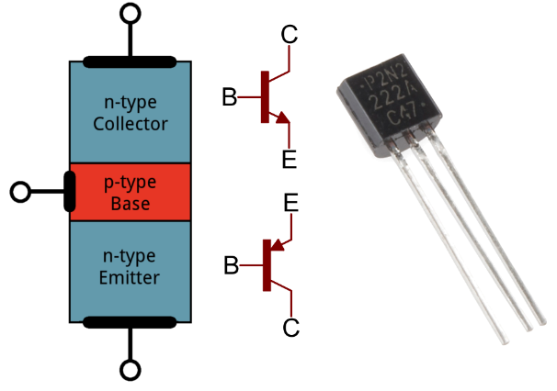

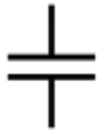
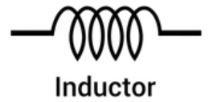
Diode A two-terminal electronic component that conducts current in one direction. It has low resistance in one direction, and high resistance in the other. | Transistor Semiconductor device used to amplify electrical signals. Voltage applied controls current through the terminals. | Resistor This is a two terminal component which provides resistance to the flow of current in a circuit. | Capacitor Stores electrical energy in its electric field and releases it whenever desired. The capacitance of a capacitor is measured in farads (F). | Inductor Stores electrical energy in the magnetic field surrounding it. Inductance is directly proportional to number of turns in the coil.

Slide 5
International System of Units
The system of units used in engineering and science is the international system of units, abbreviated to SI units, and is based on the metric system.
This was introduced in 1960 and is now adopted by most countries as the official system of measurement.
Quantity | Unit
Length | Metre, m
Mass | Kilogram, kg
Time | Second, s
Electric current | Ampere, A
Thermodynamic temperature | Kelvin, K
Luminous intensity | Candela, cd
Amount of substance | Mole, mol

Slide 6
International System of Units
SI units may be made larger or smaller by using prefixes which denote multiplication or division by a particular amount.
Write the following in a more concise form.
(a) 0.000015A (b) 0.01m (c) 11000V
Solution
(a)15μA (b) 10mm (c) 11kV
Prefix | Name | Meaning
M | mega | Multiply by 1 000 000 (i.e 10⁶)
k | kilo | Multiply by 1 000 (i.e 10³)
m | milli | Divide by 1 000 (i.e 10⁻³)
µ | Micro | Divide by 1 000 000 (i.e 10⁻⁶)
n | nano | Divide by 1 000 000 000 (i.e 10⁻⁹)
p | pico | Divide by 1 000 000 000 000 (i.e 10⁻¹²)

Slide 7
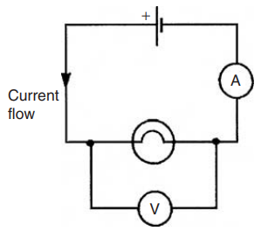
Potential Difference (e.m.f.)
A change in electric potential between two points in an electric circuit is called a potential difference, measured in volts (V).
One volt is the p.d. between two points in a conductor which, when carrying a current of one ampere dissipates a power of one watt.
The EMF provided by a source of energy such as a cell, battery or a generator is measured in volts.

Slide 8
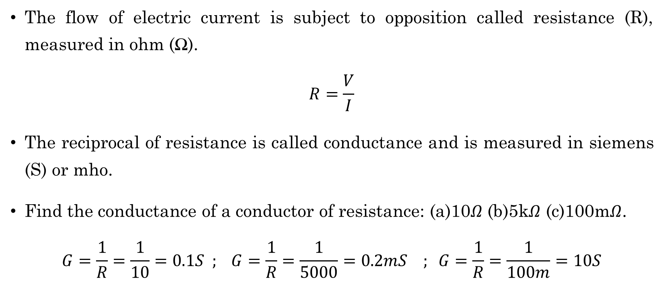
Resistance and Conductance
The flow of electric current is subject to opposition called resistance (R), measured in ohm (Ω).
$$R=\frac{V}{I}$$
The reciprocal of resistance is called conductance and is measured in siemens (S) or mho.
Find the conductance of a conductor of resistance: (a)10$Ω$ (b)5k$Ω$ (c)100m$Ω$.
$$G=\frac{1}{R}=\frac{1}{10}=0.1S ; G=\frac{1}{R}=\frac{1}{5000}=0.2mS ; G=\frac{1}{R}=\frac{1}{100m}=10S$$

Slide 9
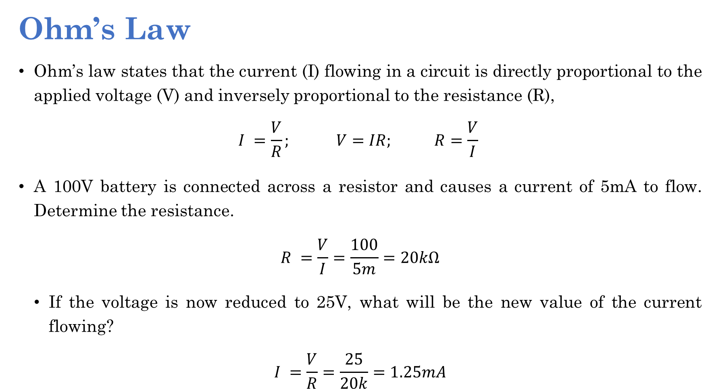
Ohm’s Law
Ohm’s law states that the current (I) flowing in a circuit is directly proportional to the applied voltage (V) and inversely proportional to the resistance (R),
$$I =\frac{V}{R}; V=IR; R=\frac{V}{I}$$
A 100V battery is connected across a resistor and causes a current of 5mA to flow. Determine the resistance.
$$R =\frac{V}{I}=\frac{100}{5m}=20kΩ$$
If the voltage is now reduced to 25V, what will be the new value of the current flowing?
$$I =\frac{V}{R}=\frac{25}{20k}=1.25mA$$

Slide 10
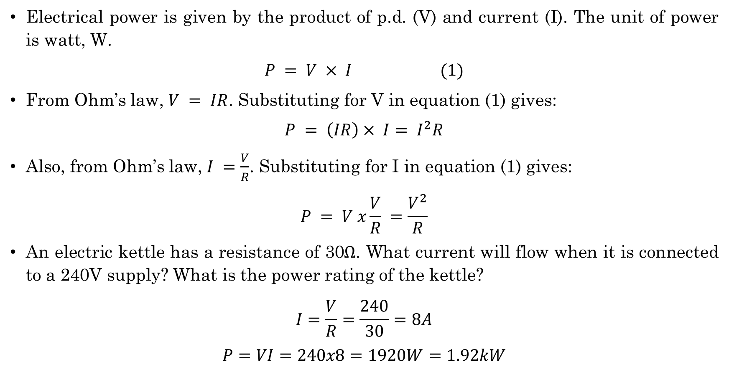
Electrical Power
Electrical power is given by the product of p.d. (V) and current (I). The unit of power is watt, W.
$$P = V × I (1)$$
From Ohm’s law, $V = IR$. Substituting for V in equation (1) gives:
$$P = \left(IR\right)× I= I^{2}R$$
Also, from Ohm’s law, $I =\frac{V}{R}$. Substituting for I in equation (1) gives:
$$P = V x\frac{V}{R} =\frac{V^{2}}{R}$$
An electric kettle has a resistance of 30$Ω$. What current will flow when it is connected to a 240V supply? What is the power rating of the kettle?
$$I=\frac{V}{R}=\frac{240}{30}=8A$$
$$P=VI=240x8=1920W=1.92kW$$

Slide 11
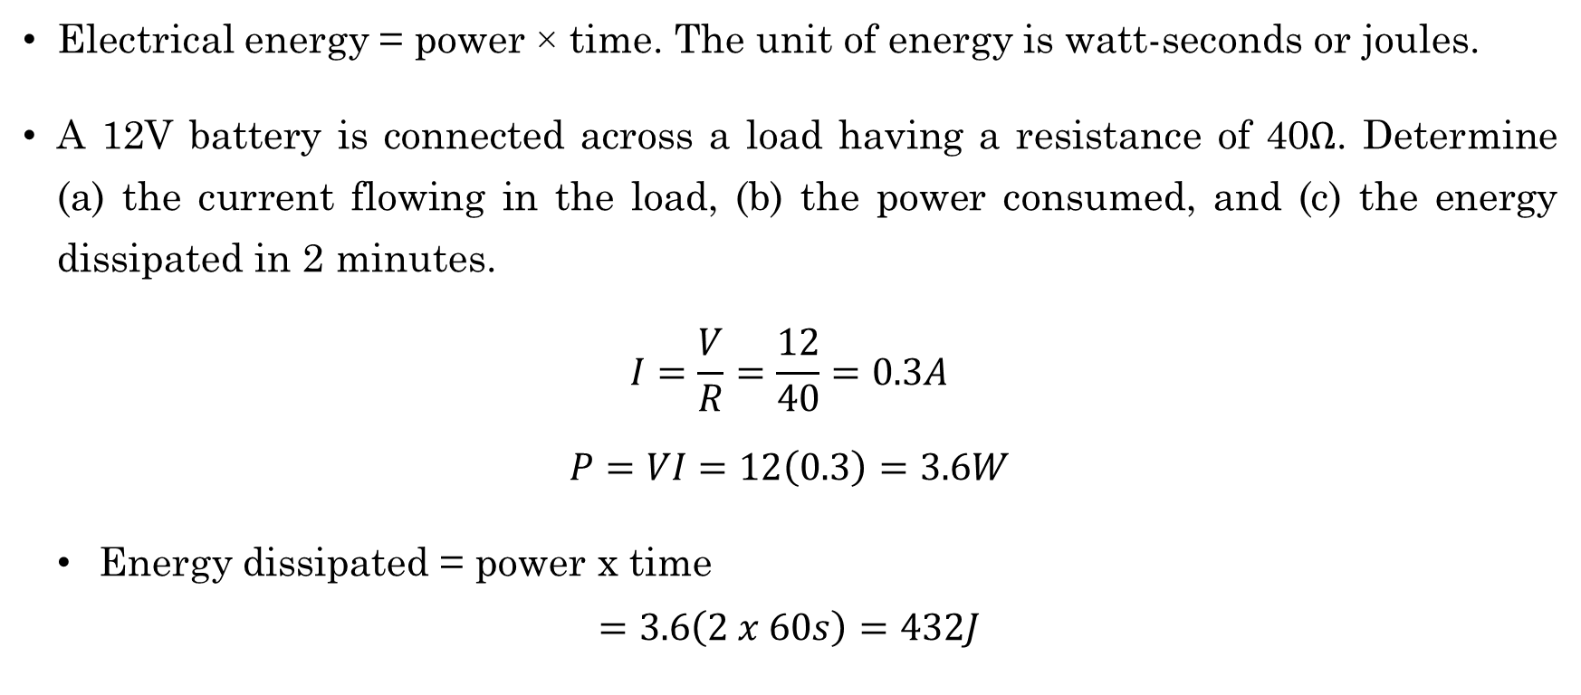
Electrical Energy
Electrical energy = power × time. The unit of energy is watt-seconds or joules.
A 12V battery is connected across a load having a resistance of 40$Ω$. Determine (a) the current flowing in the load, (b) the power consumed, and (c) the energy dissipated in 2 minutes.
$$I=\frac{V}{R}=\frac{12}{40}=0.3A$$
$$P=VI=12\left(0.3\right)=3.6W$$
Energy dissipated = power x time
$$=3.6\left(2 x 60s\right)=432J$$

Slide 12
Basic electrical measuring instruments
An ammeter - instrument used to measure current and must be connected in series with the circuit.
A voltmeter - instrument used to measure p.d. and must be connected in parallel with the required circuit.
An ohmmeter - instrument for measuring resistance.
A multimeter - used to measure voltage, current and resistance.
The oscilloscope - used to observe waveforms and to measure voltages and currents.

Slide 13
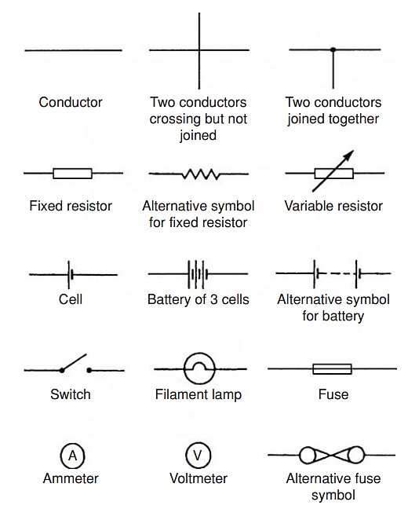
Standard symbols for electrical components

Slide 14
*End of session*

Slide 15
Questions….?

